Slide 1

7th Grade Accelerated Math
Unit 2, Lesson 2 Square Values and Square Roots Volume 1, pg. 68

Slide 2


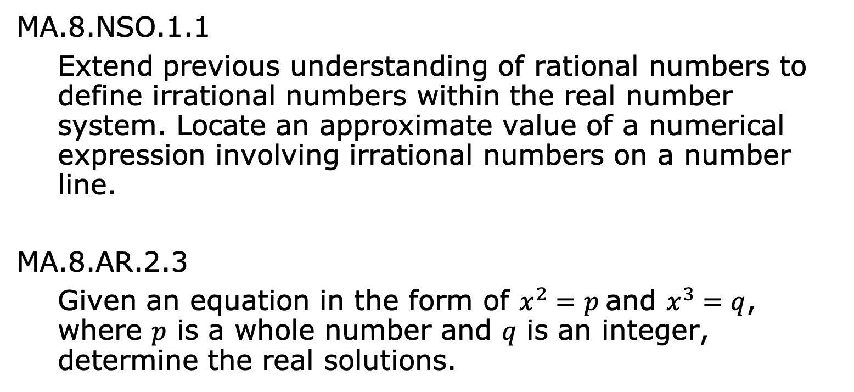
Benchmarks
MA.8.NSO.1.1
Extend previous understanding of rational numbers to define irrational numbers within the real number system. Locate an approximate value of a numerical expression involving irrational numbers on a number line.
MA.8.AR.2.3
Given an equation in the form of $x^{2}=p$ and $x^{3}=q$, where 𝑝 is a whole number and 𝑞 is an integer, determine the real solutions.
volume 1, pg. 68

Slide 3
Integrated Mathematical Thinking and Reasoning Standards
MA.K12.MTR.3.1 Complete tasks with mathematical fluency.
MA.K12.MTR.5.1 Use patterns and structure to help understand and connect mathematical concepts.
volume 1, pg. 68

Slide 4

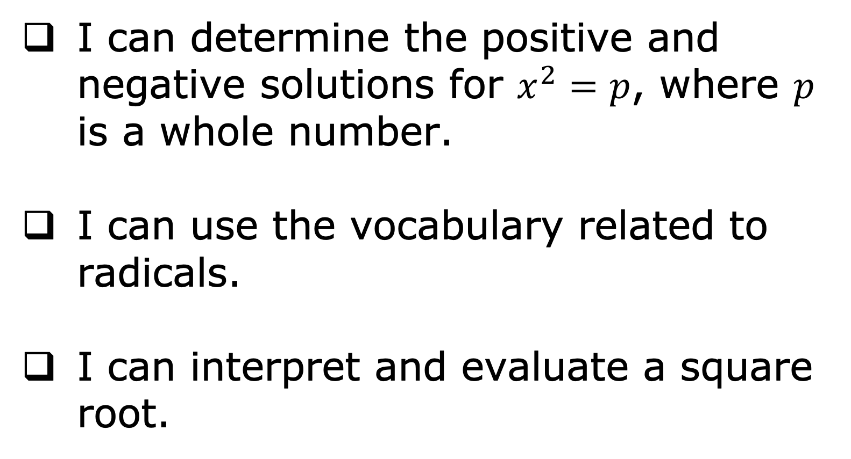
Learning Targets
I can determine the positive and negative solutions for $x^{2}=p$, where $p$ is a whole number.
I can use the vocabulary related to radicals.
I can interpret and evaluate a square root.
volume 1, pg. 68

Slide 5

Warm-Up
volume 1, pg. 69

Slide 6
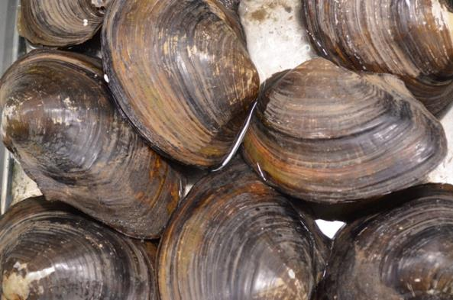
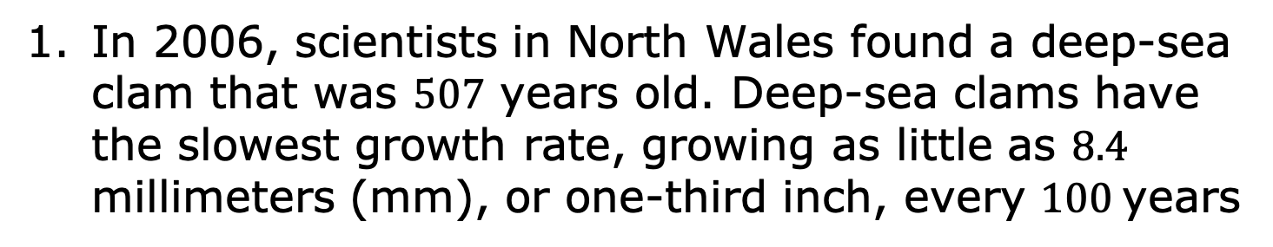
2.2.1 Warm-Up: Estimation
In 2006, scientists in North Wales found a deep-sea clam that was $507$ years old. Deep-sea clams have the slowest growth rate, growing as little as $8.4$ millimeters (mm), or one-third inch, every $100$ years
volume 1, pg. 69

Slide 7
Estimate the clam’s size when the scientists found it in 2006.
Explain your reasoning for your estimation.
volume 1, pg. 69

Slide 8

Guided Instruction
volume 1, pg. 69

Slide 9
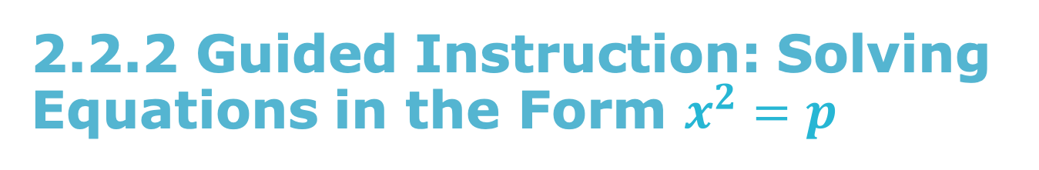
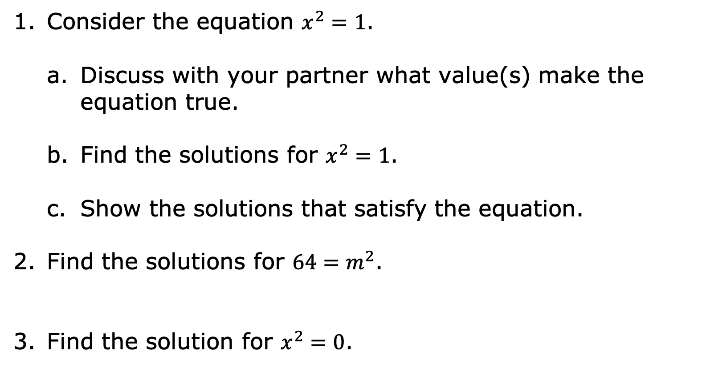
2.2.2 Guided Instruction: Solving Equations in the Form $x^{2}=p$
Consider the equation $x^{2}=1$.
Discuss with your partner what value(s) make the equation true.
Find the solutions for $x^{2}=1$.
Show the solutions that satisfy the equation.
Find the solutions for $64=m^{2}$.
Find the solution for $x^{2}=0$.
volume 1, pg. 69

Slide 10
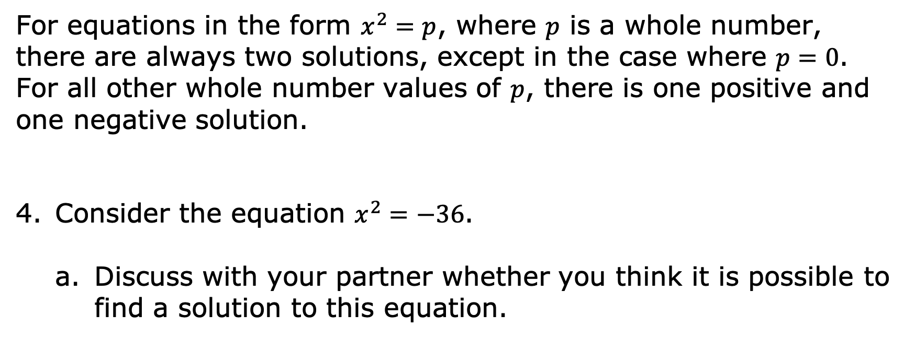
For equations in the form $x^{2}=p$, where $p$ is a whole number, there are always two solutions, except in the case where $p=0$. For all other whole number values of $p$, there is one positive and one negative solution.
Consider the equation $x^{2}=−36$.
Discuss with your partner whether you think it is possible to find a solution to this equation.
volume 1, pg. 70

Slide 11
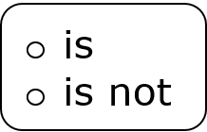
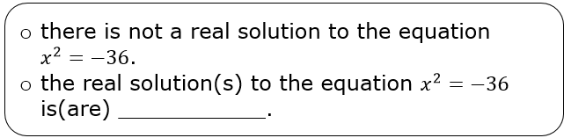
Complete the statements.
There
a real number that can be
multiplied by itself to result in $−36$. Therefore,
volume 1, pg. 70

Slide 12

Try It
volume 1, pg. 70

Slide 13

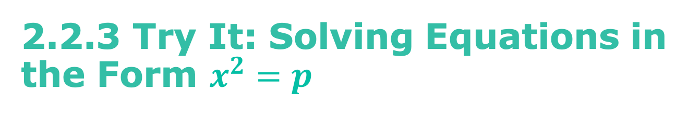

2.2.3 Try It: Solving Equations in the Form $x^{2}=p$
Find the solution(s) for each equation.
$x^{2}=36$
$t^{2}=144$
$49=n^{2}$
volume 1, pg. 70

Slide 14
Guided Instruction
volume 1, pg. 71

Slide 15
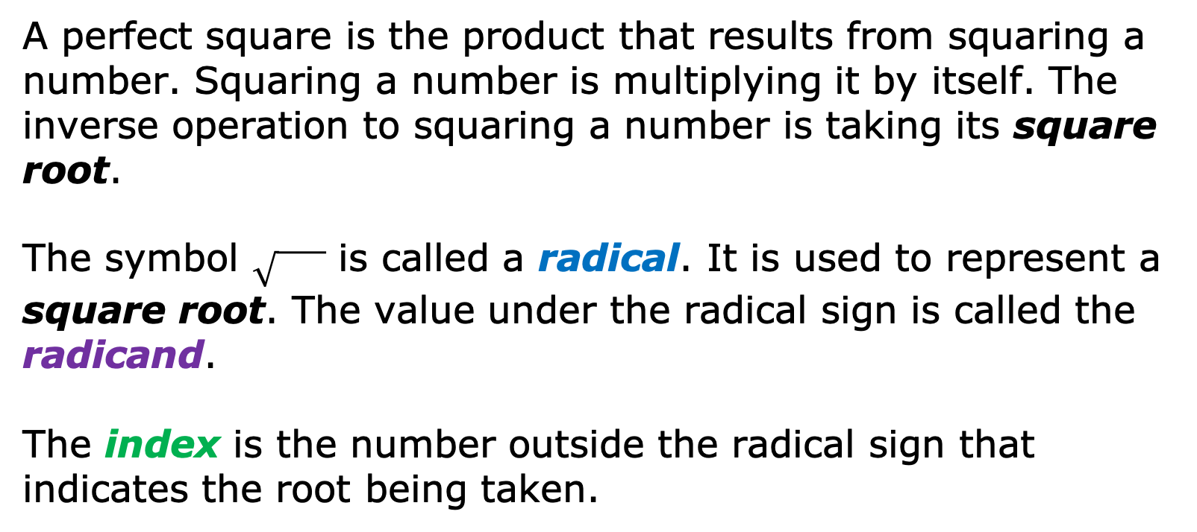
2.2.4 Guided Instruction: Square Roots
A perfect square is the product that results from squaring a number. Squaring a number is multiplying it by itself. The inverse operation to squaring a number is taking its square root.
The symbol is called a radical. It is used to represent a square root. The value under the radical sign is called the radicand.
The index is the number outside the radical sign that indicates the root being taken.
volume 1, pg. 71

Slide 16
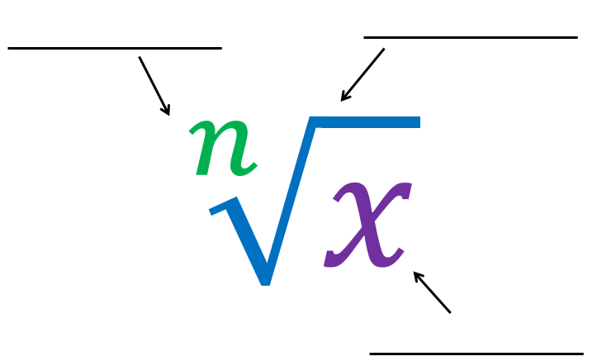
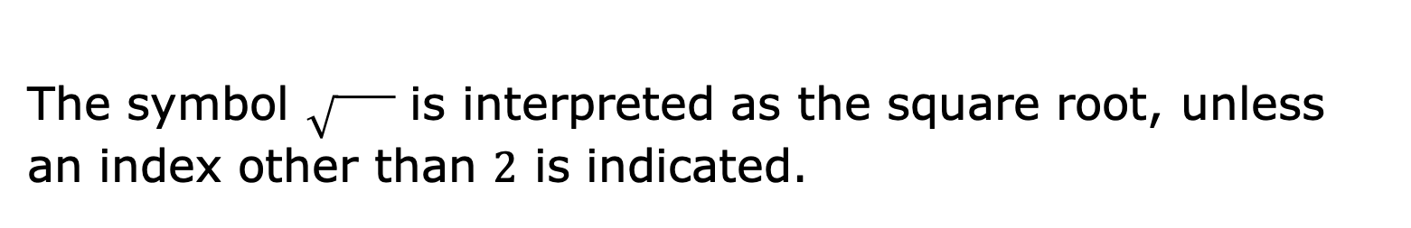
Use this information to label the parts of a radical expression.
The symbol is interpreted as the square root, unless an index other than $2$ is indicated.
volume 1, pg. 71

Slide 17
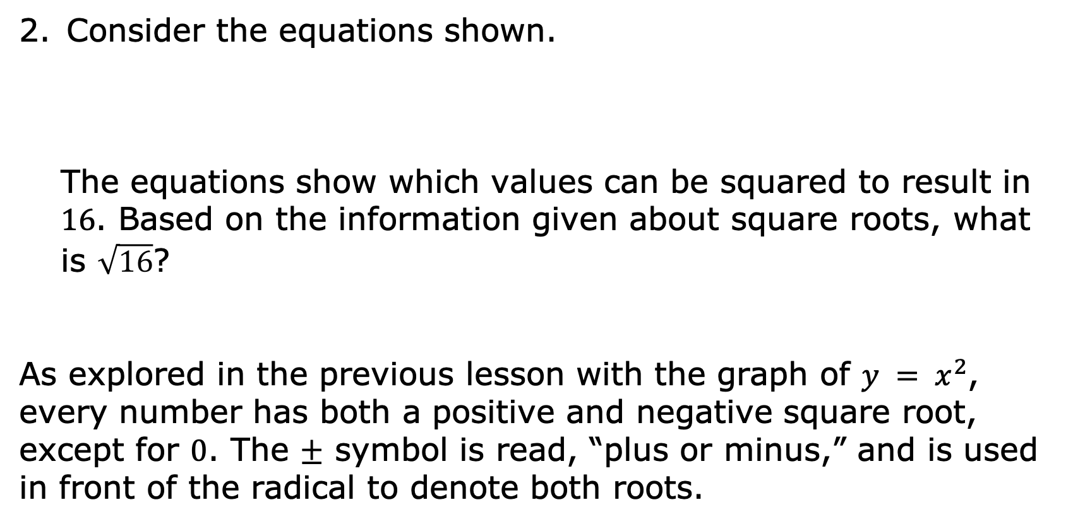
Consider the equations shown.
The equations show which values can be squared to result in $16$. Based on the information given about square roots, what is $\sqrt{16}$?
As explored in the previous lesson with the graph of $y = x^{2}$, every number has both a positive and negative square root, except for $0$. The $±$ symbol is read, “plus or minus,” and is used in front of the radical to denote both roots.
$${(4)}^{2}=16$$ | $${(−4)}^{2}=16$$
volume 1, pg. 71

Slide 18
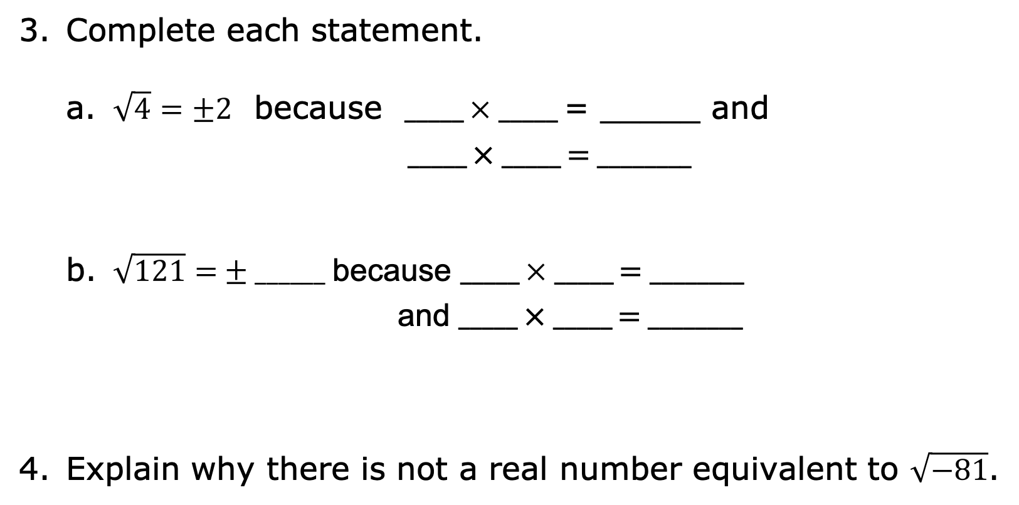
Complete each statement.
$\sqrt{4}=±2$ because _____ $×$_____ = _____ and
_____ $×$_____ = ________
$\sqrt{121}=$ $± ______$ because _____ $×$_____ = ________
and _____ $×$_____ = ________
Explain why there is not a real number equivalent to $\sqrt{−81}$.
volume 1, pg. 71

Slide 19

Guided Practice
volume 1, pg. 72

Slide 20

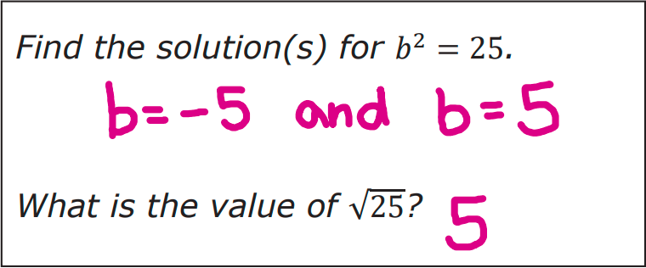
2.2.5 Guided Practice: Squares and Square Roots
Xavier completed two problems as shown.
Discuss Xavier’s answers with your partner.
volume 1, pg. 72

Slide 21
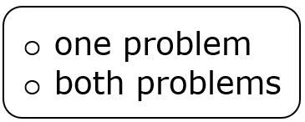
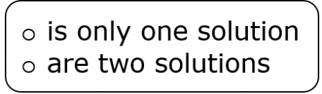
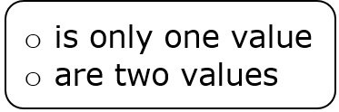
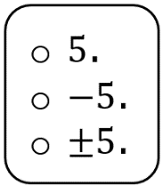
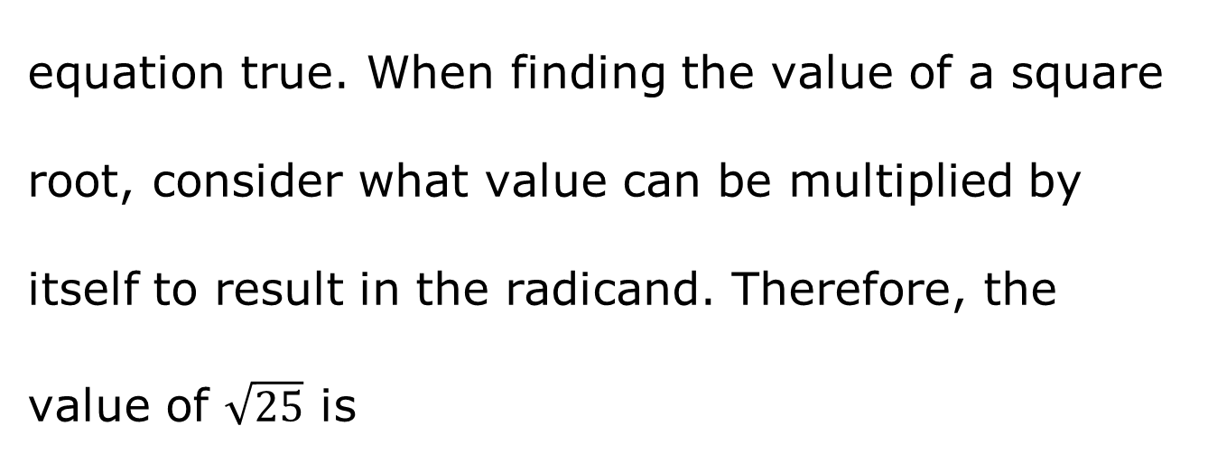
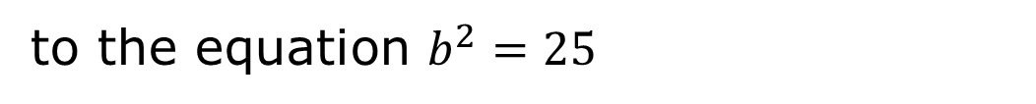
Complete the statements.
Xavier answered correctly.
There
to the equation $b^{2}=25$
because there
that make(s) the
equation true. When finding the value of a square root, consider what value can be multiplied by itself to result in the radicand. Therefore, the value of $\sqrt{25}$ is
volume 1, pg. 72

Slide 22
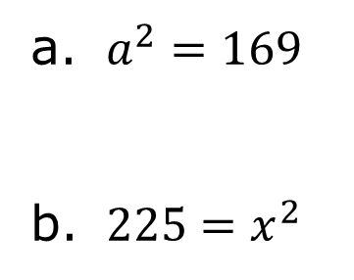
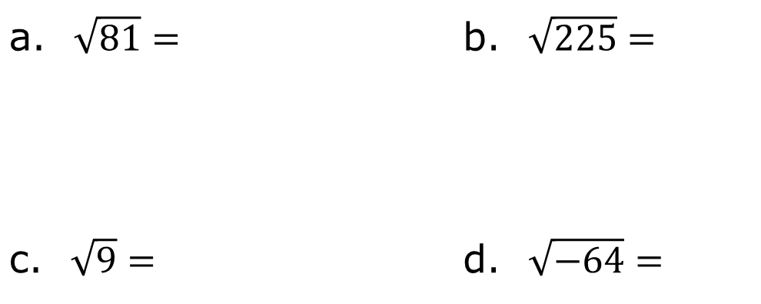
Find the value of each of the following.
a. $\sqrt{81}=$ | b. $\sqrt{225}=$
c. $\sqrt{9}=$ | d. $\sqrt{−64}=$
Solve each equation.
$a^{2}=169$
$225=x^{2}$
volume 1, pg. 72

Slide 23

Your Turn
volume 1, pg. 72

Slide 24
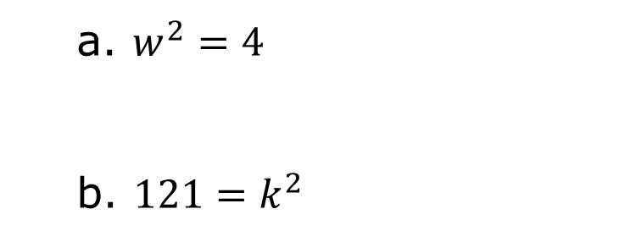
2.2.6 Your Turn!
Find the value of each of the following.
Solve each equation.
$\sqrt{49}=$ | $\sqrt{196}=$
$w^{2}=4$
$121=k^{2}$
volume 1, pg. 72

Slide 25

Wrap-Up
volume 1, pg. 72

Slide 26
2.2.7 Wrap-Up: Reflection
Choose two statements to complete as you reflect on today’s lesson.
One thing that made the most sense to me today was …
One thing that I just don’t understand is …
One thing I learned today was …
One thing I still wonder about is …
One thing I noticed about square roots is …
volume 1, pg. 72

